Slide 1
Graphical Demonstration of Slack Variables and binding/non-binding constraints

Slide 2
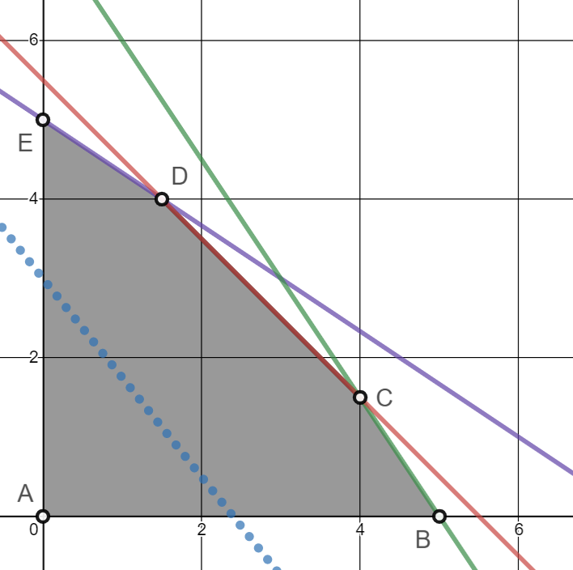

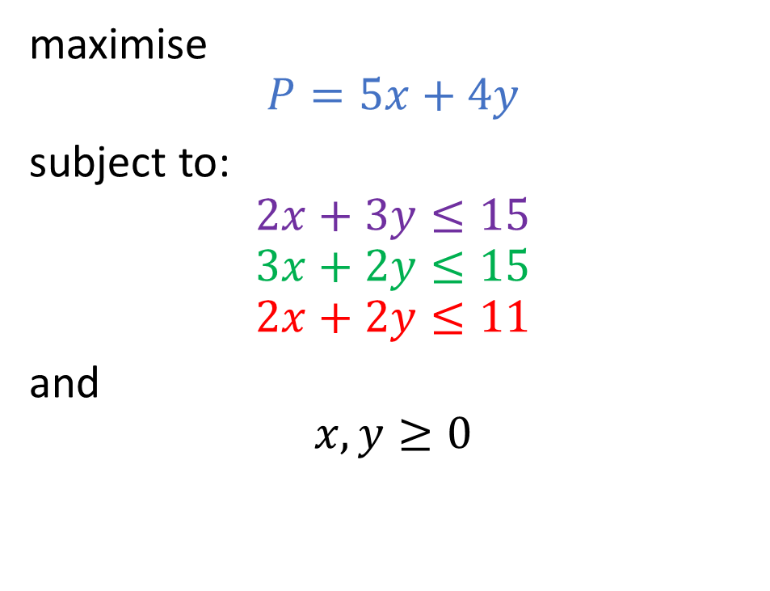
Standard Linear Program
maximise
$$P=5x+4y$$
subject to:
$$2x+3y≤15 \\ 3x+2y≤15 \\ 2x+2y≤11$$
and
$$x,y≥0$$
P = 12
Point A has an objective value of
$$P=5⋅0+4⋅0=0$$

Slide 3
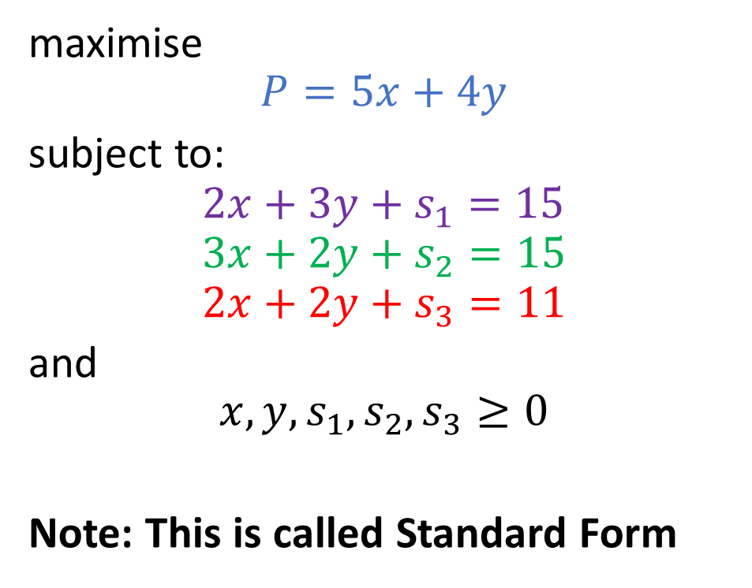

Introduce slack variables
maximise
$$P=5x+4y$$
subject to:
$$2x+3y≤15 \\ 3x+2y≤15 \\ 2x+2y≤11$$
and
$$x,y≥0$$
maximise
$$P=5x+4y$$
subject to:
$$2x+3y+s_{1}=15 \\ 3x+2y+s_{2}=15 \\ 2x+2y+s_{3}=11$$
and
$$x,y,s_{1},s_{2},s_{3}≥0$$
Note: This is called Standard Form

Slide 4
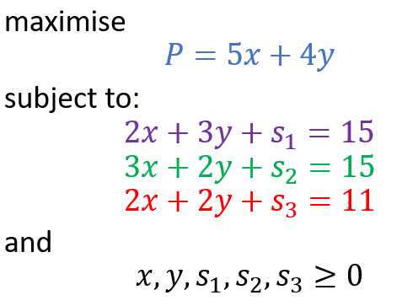
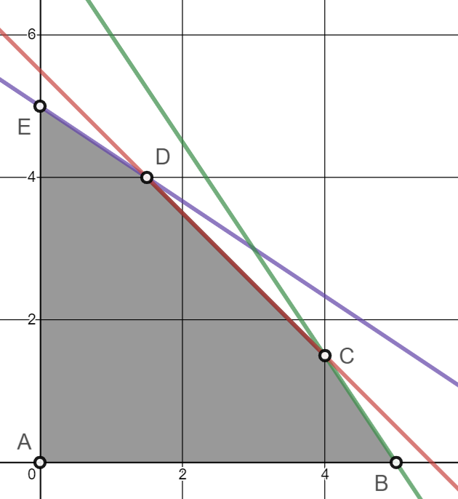
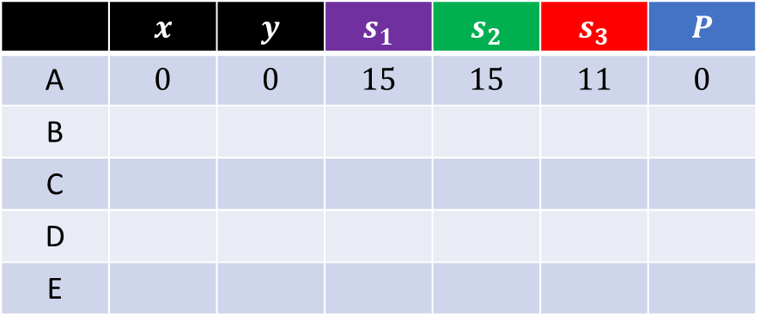
 | $$x$$ | $$y$$ | $$s_{1}$$ | $$s_{2}$$ | $$s_{3}$$ | $$P$$
A | $$0$$ | $$0$$ | $$15$$ | $$15$$ | $$11$$ | $$0$$
B
C
D
E

Slide 5
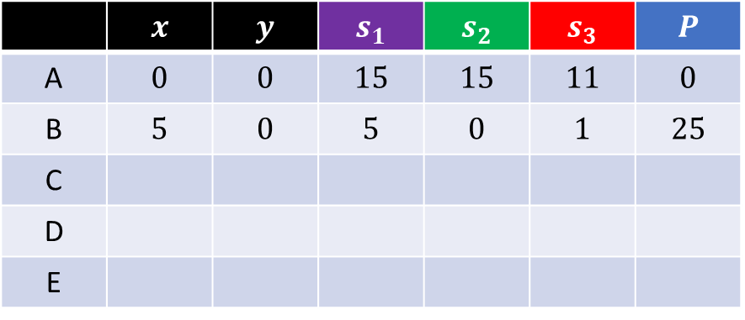
 | $$x$$ | $$y$$ | $$s_{1}$$ | $$s_{2}$$ | $$s_{3}$$ | $$P$$
A | $$0$$ | $$0$$ | $$15$$ | $$15$$ | $$11$$ | $$0$$
B | $$5$$ | $$0$$ | $$5$$ | $$0$$ | $$1$$ | $$25$$
C
D
E

Slide 6
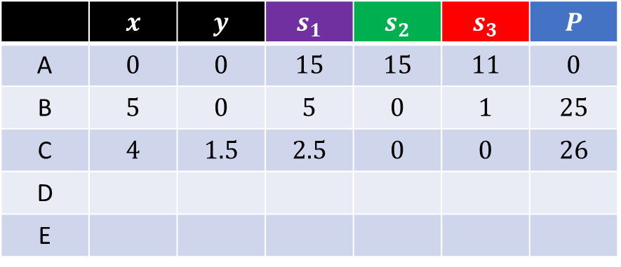
 | $$x$$ | $$y$$ | $$s_{1}$$ | $$s_{2}$$ | $$s_{3}$$ | $$P$$
A | $$0$$ | $$0$$ | $$15$$ | $$15$$ | $$11$$ | $$0$$
B | $$5$$ | $$0$$ | $$5$$ | $$0$$ | $$1$$ | $$25$$
C | $$4$$ | $$1.5$$ | $$2.5$$ | $$0$$ | $$0$$ | $$26$$
D
E

Slide 7
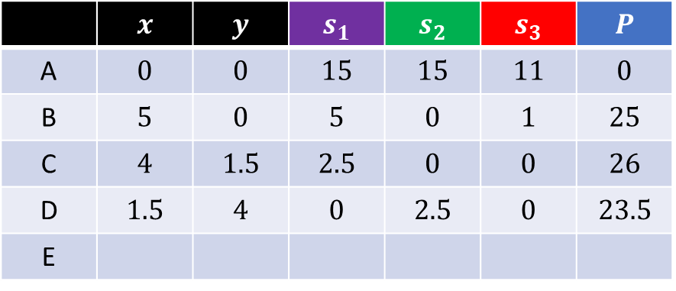
 | $$x$$ | $$y$$ | $$s_{1}$$ | $$s_{2}$$ | $$s_{3}$$ | $$P$$
A | $$0$$ | $$0$$ | $$15$$ | $$15$$ | $$11$$ | $$0$$
B | $$5$$ | $$0$$ | $$5$$ | $$0$$ | $$1$$ | $$25$$
C | $$4$$ | $$1.5$$ | $$2.5$$ | $$0$$ | $$0$$ | $$26$$
D | $$1.5$$ | $$4$$ | $$0$$ | $$2.5$$ | $$0$$ | $$23.5$$
E

Slide 8
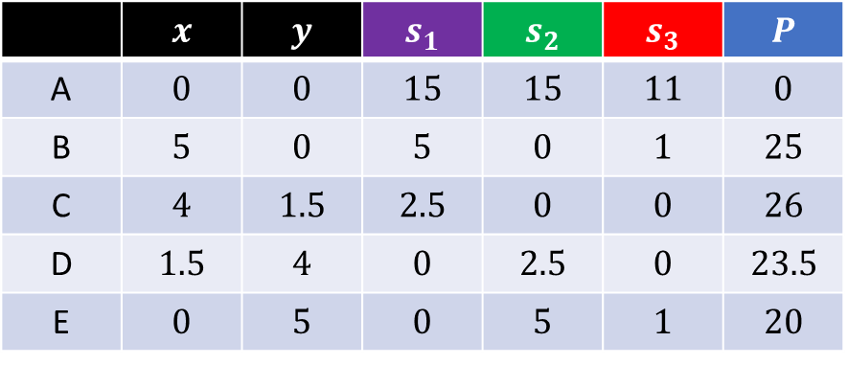
 | $$x$$ | $$y$$ | $$s_{1}$$ | $$s_{2}$$ | $$s_{3}$$ | $$P$$
A | $$0$$ | $$0$$ | $$15$$ | $$15$$ | $$11$$ | $$0$$
B | $$5$$ | $$0$$ | $$5$$ | $$0$$ | $$1$$ | $$25$$
C | $$4$$ | $$1.5$$ | $$2.5$$ | $$0$$ | $$0$$ | $$26$$
D | $$1.5$$ | $$4$$ | $$0$$ | $$2.5$$ | $$0$$ | $$23.5$$
E | $$0$$ | $$5$$ | $$0$$ | $$5$$ | $$1$$ | $$20$$

Slide 9
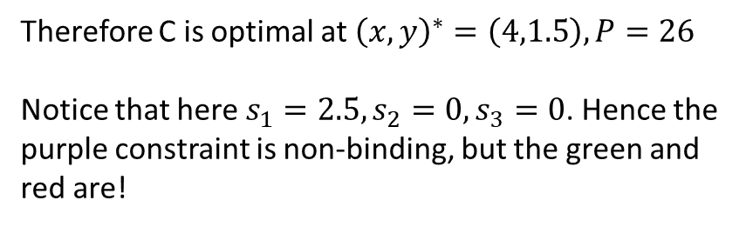
Therefore C is optimal at ${\left(x,y\right)}^{∗}=\left(4,1.5\right), P=26$
Notice that here $s_{1}=2.5, s_{2}=0,s_{3}=0$. Hence the purple constraint is non-binding, but the green and red are!
 | $$x$$ | $$y$$ | $$s_{1}$$ | $$s_{2}$$ | $$s_{3}$$ | $$P$$
A | $$0$$ | $$0$$ | $$15$$ | $$15$$ | $$11$$ | $$0$$
B | $$5$$ | $$0$$ | $$5$$ | $$0$$ | $$1$$ | $$25$$
C | $$4$$ | $$1.5$$ | $$2.5$$ | $$0$$ | $$0$$ | $$26$$
D | $$1.5$$ | $$4$$ | $$0$$ | $$2.5$$ | $$0$$ | $$23.5$$
E | $$0$$ | $$5$$ | $$0$$ | $$5$$ | $$1$$ | $$20$$
*

Slide 10
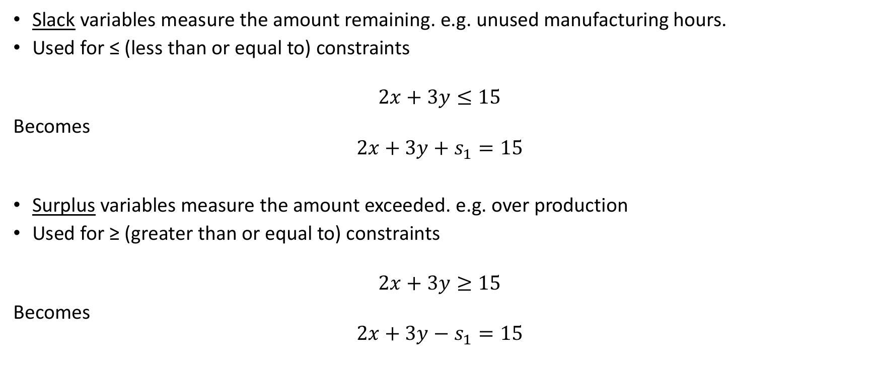
Slack Variable ‘vs’ Surplus Variable
Slack variables measure the amount remaining. e.g. unused manufacturing hours.
Used for ≤ (less than or equal to) constraints
$$2x+3y≤15$$
Becomes
$$2x+3y+s_{1}=15$$
Surplus variables measure the amount exceeded. e.g. over production
Used for ≥ (greater than or equal to) constraints
$$2x+3y≥15$$
Becomes
$$2x+3y−e_{1}=15$$

